Slide 1

Company XYZ: An Innovative Clustering Healthcare Insurance Solution
Hannah Cronin

Slide 2
The Problem:
Company XYZ needs a better solution to categorize their new customers
It is a Health Care Insurance company
Revenues are generated off customer premiums
Customers need to be sorted based of health history, lifestyle, and demographic information into appropriate groups
These groups pay different premiums accordingly

Slide 3
The Approach:
Using a non-hierarchical clustering algorithm (Kmeans()), we can:
Create the appropriate numbers of clusters for the customer base:
Too many clusters and the clusters may get too specific and focus on a singular factor rather than the aggregate data of the person
Too few clusters and the company is not able to determine who may need to pay higher premiums based upon their information
Kmeans() uses Euclidean distance as the metric, this means that:
Correlations are ignored
Correlation is not causation
This avoids unfairly sorting consumers based off spurious correlations
Euclidean distance and Kmeans() is commonly used approach in healthcare data analytics

Slide 4
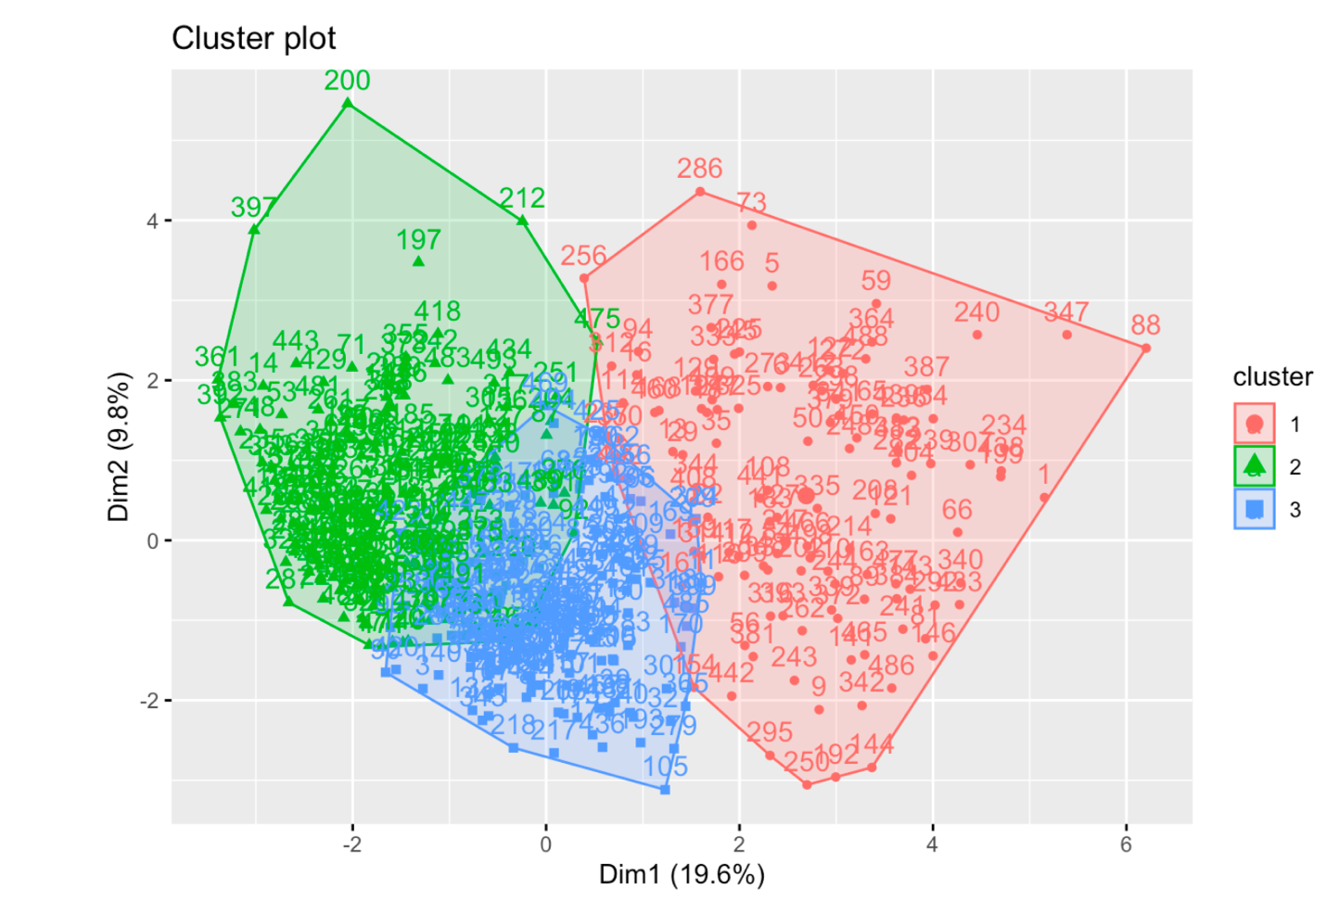
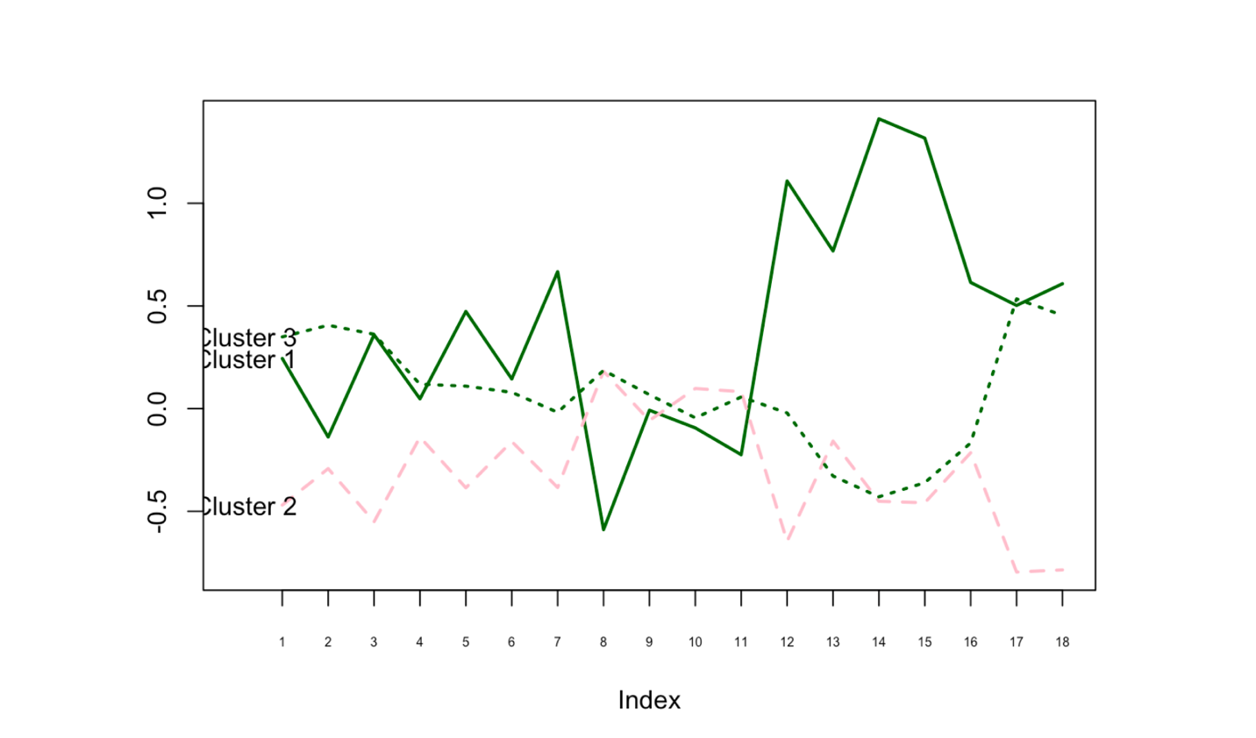
The Results
3 Clusters - (Younger & In Better Health, Middle-Aged and in Poorer Health, Older & in Fair Health)
Company XYZ can fairly sort its consumers based on a variety of factors like age, general health, BMI, smoking habits, history of heart disease, history of stroke, activity levels and more
This ensures that customers are being treated fairly and Company XYZ can charge them appropriately in order to both make money and stay competitive
If customers are charged too much, they will pick an alternative competitor.
This solutions boosts both business operations and customer retention.

